Slide 1
Orion
Nbhd Profiles
2024 ORION USERS CONFERENCE

Slide 2
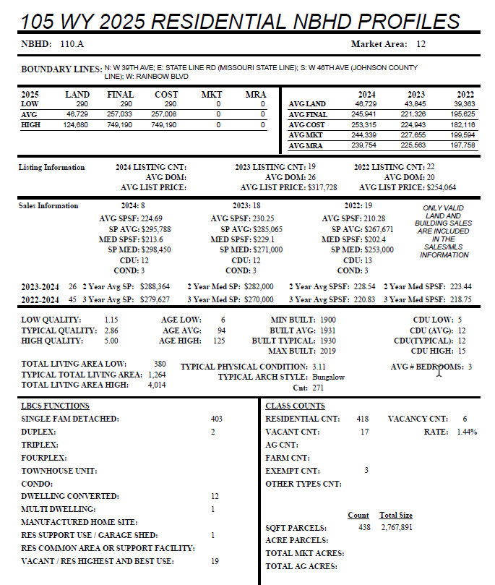
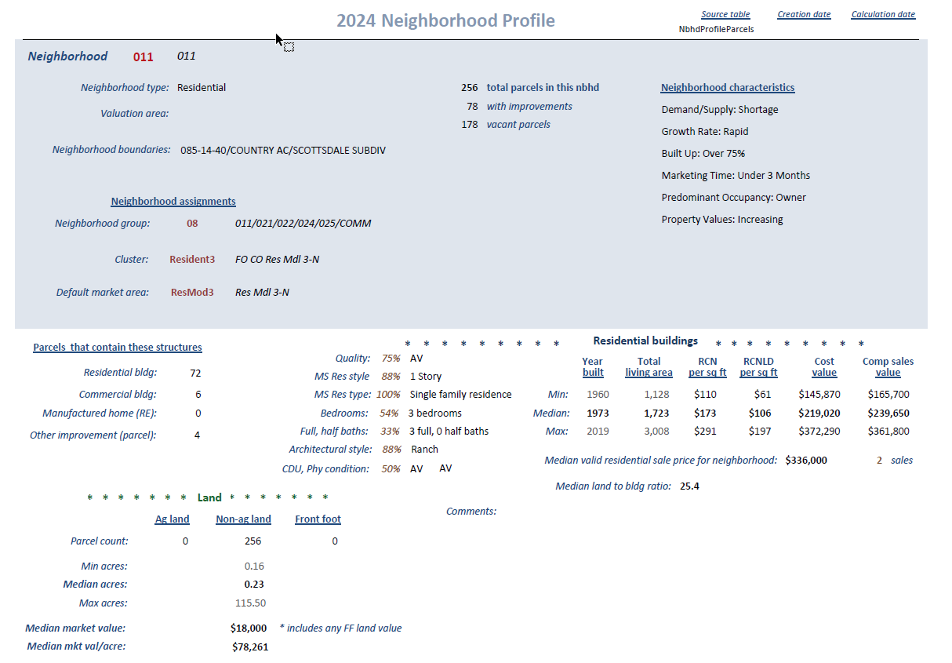
Where it started
Wyandotte County’s version (external source) combined with the CRS Extract Profile

Slide 3
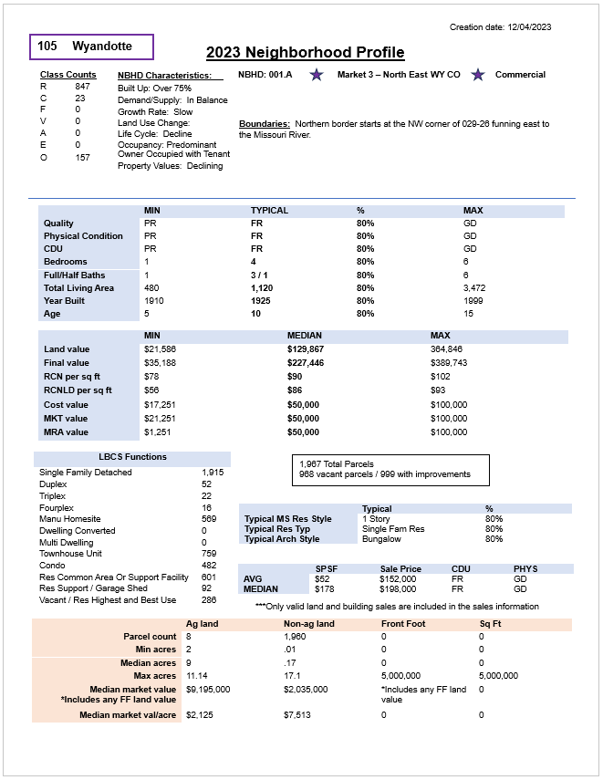
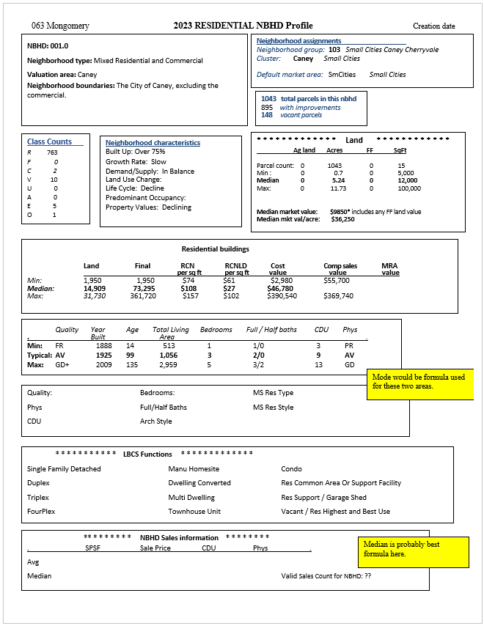
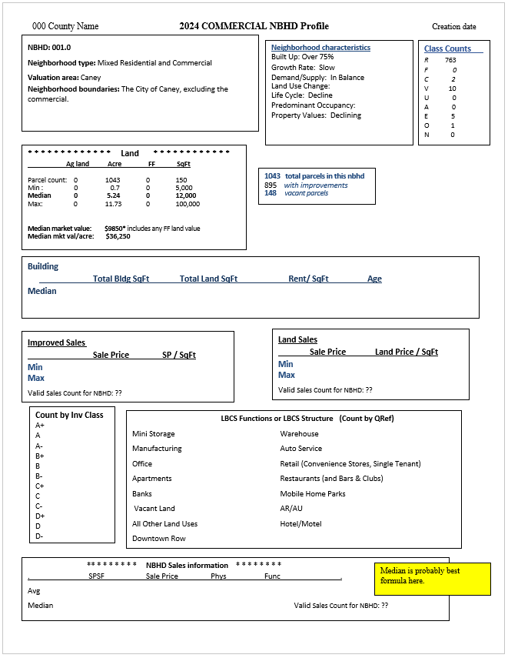
Nbhd Profile Drafts
Res Profile Ex 1
Res Profile Ex 2
Com Profile

Slide 4
Layout
Fields
Layout
Fields
2024 ORION USERS CONFERENCE

